Slide 1

MDA- UAW Local 571
Apparel Catalog 2026
Wear Your MDA UAW Local-571 Logo
On Union Made Apparel
Prices shown in this catalog are half the total cost of each item; this total is the members cost for the item. Your local MDA UAW Local 571 picks up the other half.
03/25/26

Slide 2
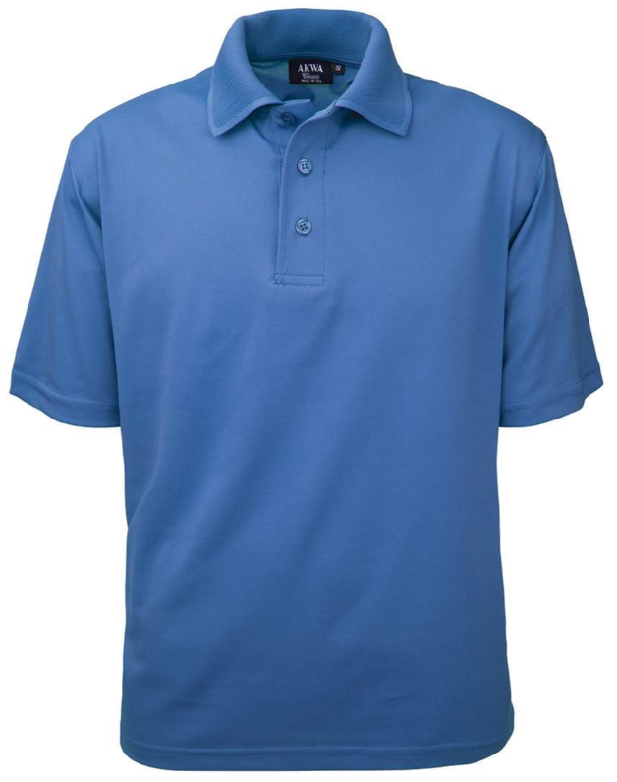
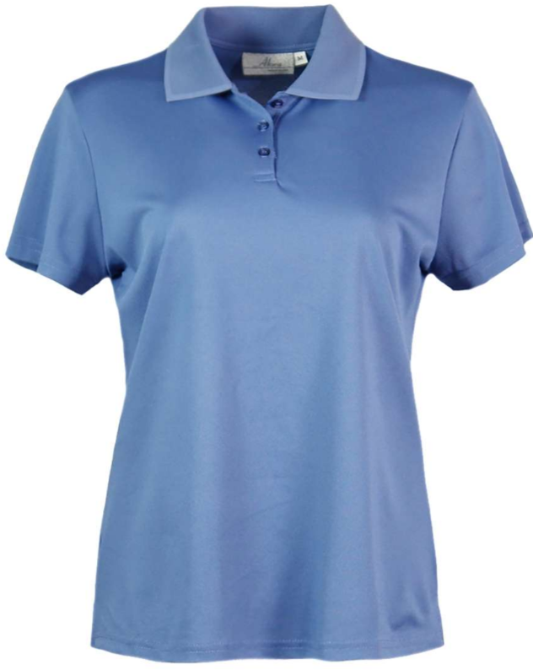
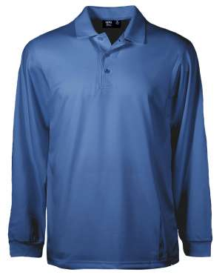



















Men’s & Ladies’ Aqua-Dry Pique (AQD)
5.4 oz, 96/4 Dry Wicking Poly/Spandex
BEST no-curl collar in the industry, Resists snagging and wrinkling, Moisture wicking
Men’s 1342-AQD Available: Small to 4XL
Small to XL: | $30.50
2XL: | $32.50
3XL: | $34.50
4XL: | $36.50
Ladies’ 234-AQD Available: Small to 3XL
Small to XL: | $30.50
2XL: | $32.50
3XL: | $34.50
LS1342-AQD Available: Small to 4XL
Small to XL: | $33.50
2XL: | $35.50
3XL: | $37.50
4XL: | $39.50
Aquatic Black Burgundy Heather French Hunter Lime Navy Olive Red Royal Rust Sage Steel Stone White Yellow Heather Purple
Blue Charcoal Blue Blue Blue Grey
Page 2

Slide 3
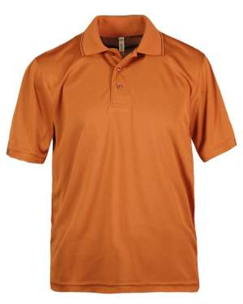
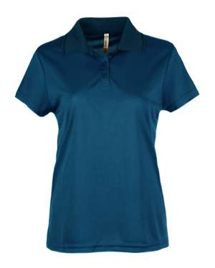






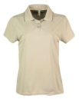
Men’s & Ladies’ Bamboo Polo Shirt
Thin bamboo layer on interior, dry wicking poly mesh on exterior, contrasting tipping on collar & cuff
Men’s 1353-BCM Available: Small to 4XL
Small to XL: | $30.50
2XL: | $32.00
3XL: | $33.50
4XL: | $35.50
Ladies’ 208-BCM Available: Small to 3XL
Small to XL: | $30.50
2XL: | $32.00
3XL: | $33.50
Men’s only is also available in Rust color
Black Denim French Olive Red Silver Stone
Blue
Page 3

Slide 4
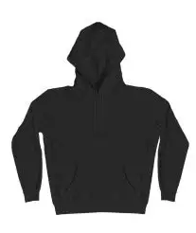

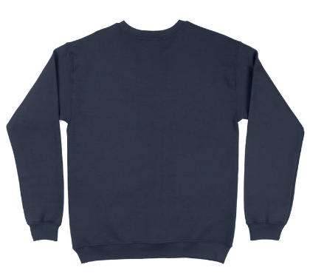

Unisex Pullover Hoodie
100% Combed Ring Spun Cotton Fleece 7.2 oz/sq yd
Unisex Crewneck Sweatshirt
100% Combed Ring Spun Cotton Fleece 7.2 oz/sq yd
Unisex 13155 Available: XS to 3X
XS to XL: | $25.00
2XL: | $27.00
3XL: | $29.00
Unisex 13159 Available: XS to 3X
XS to XL: | $23.00
2XL: | $25.00
3XL: | $27.00
Army Asphalt black heather navy white rock
Page 4

Slide 5
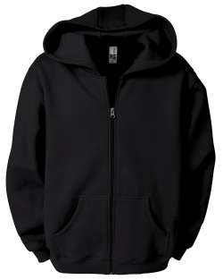
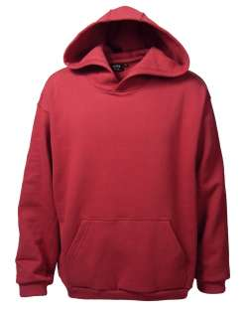
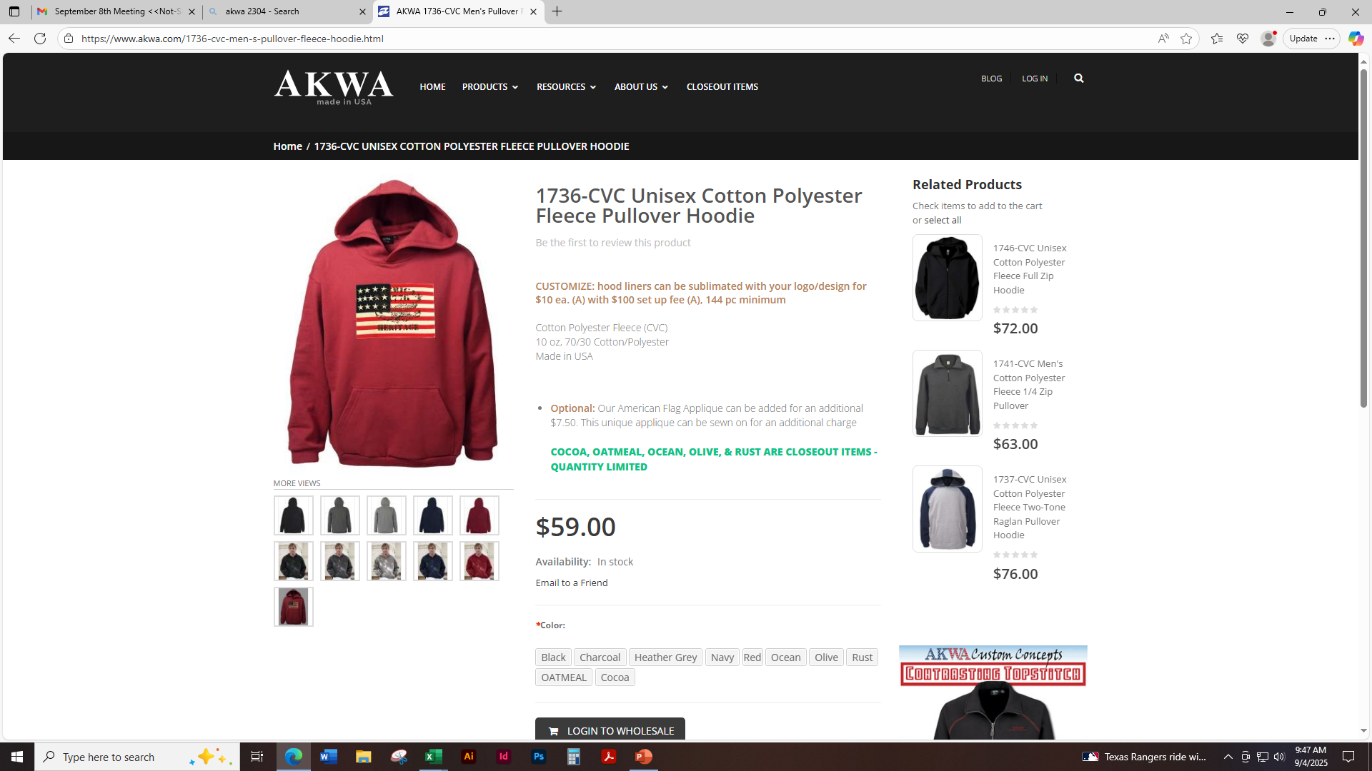
Unisex Full Zip Fleece Hoodie
Cotton Polyester Fleece (CVC) 10 oz, 70/30 Cotton/Polyester
Unisex Pullover Fleece Hoodie
Cotton Polyester Fleece (CVC)
10 oz, 70/30 Cotton/Polyester
1746-CVC Full Zip Hoodie Available: Small to 4XL
Small to XL: | $40.00
2XL: | $42.00
3XL: | $44.00
4XL: | $46.00
1736-CVC Pullover Hoodie Available: Small to 4XL
Small to XL: | $33.50
2XL: | $35.50
3XL: | $37.50
4XL: | $39.50
Black Charcoal Heather Grey Navy Blue Red
Page 5

Slide 6
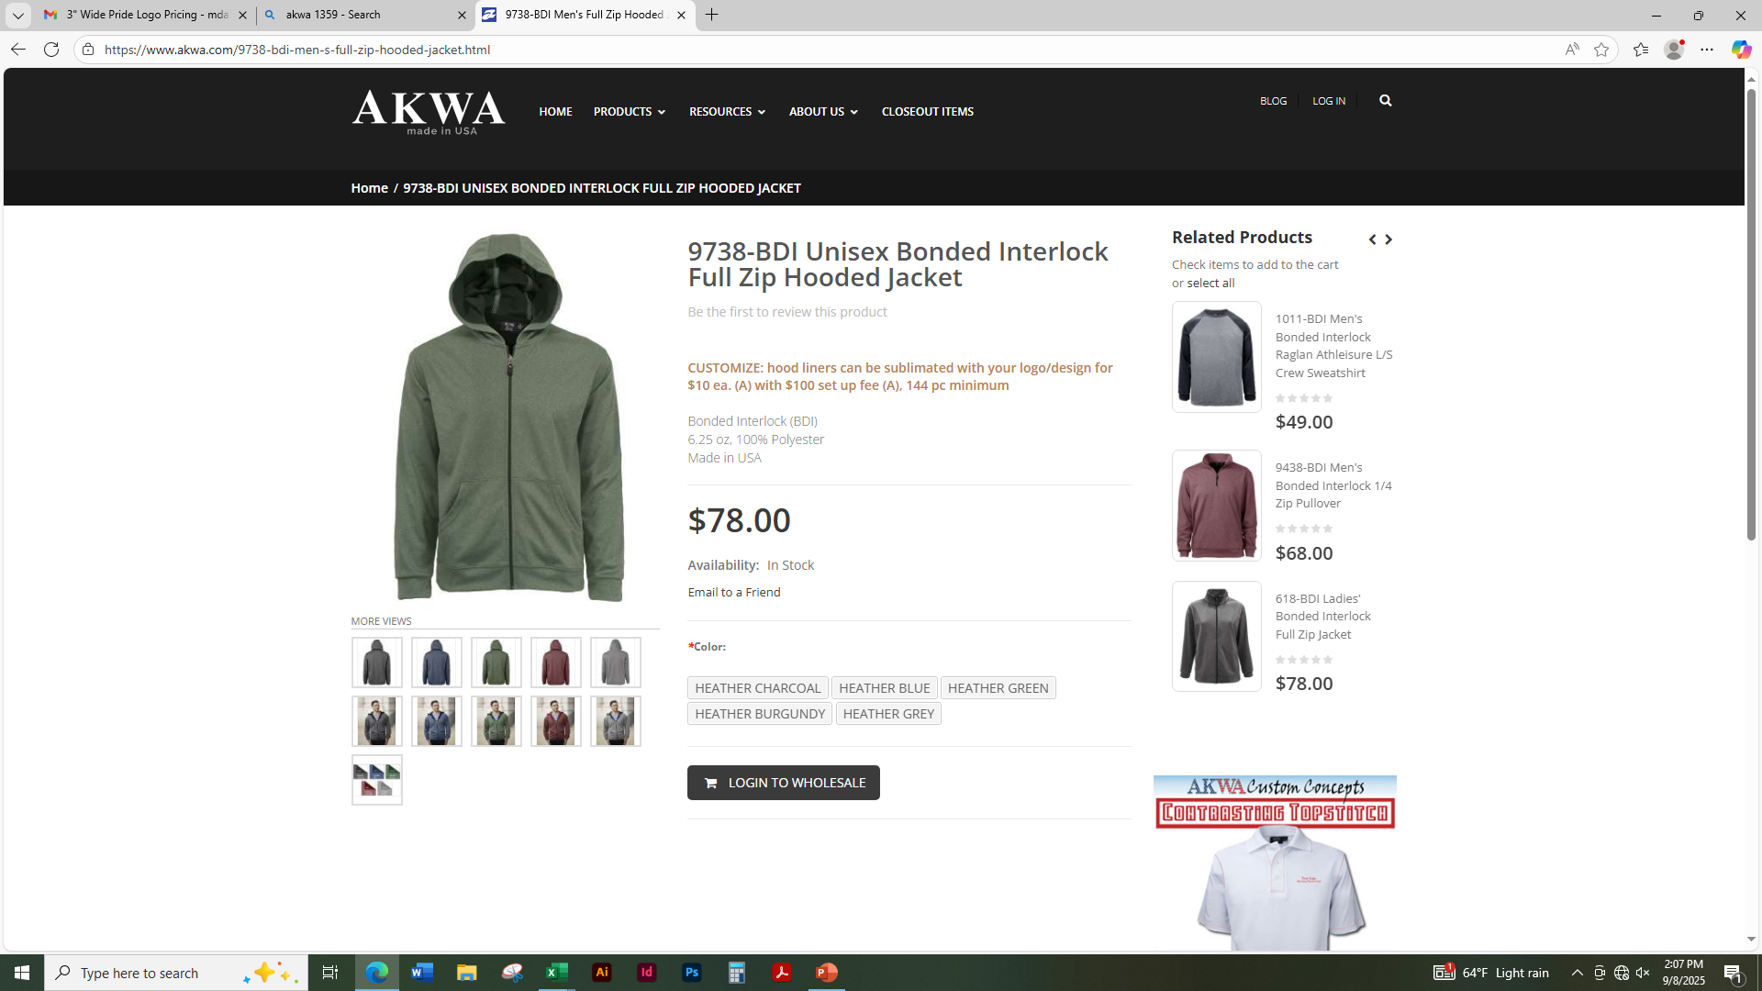
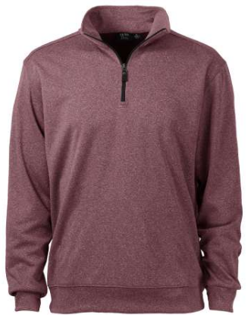
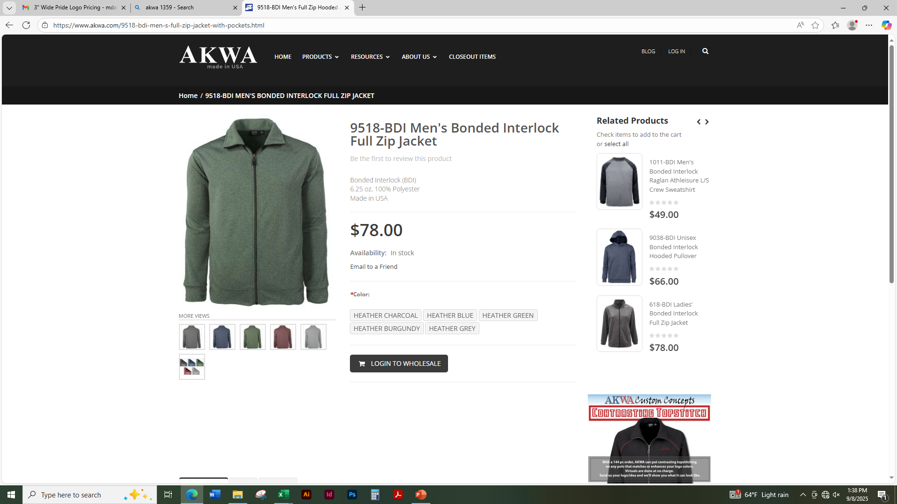
Men’s Full Zip Hooded Jacket 6.25 oz, 100% Polyester
With heather exterior and solid lining
Heather exterior is water repellent
Men’s ¼ Zip Pullover
6.25 oz, 100% Polyester
With heather exterior and solid lining
Heather exterior is water repellent
Men’s 9738-BDI Available: Small to 4XL
Small to XL: | $41.00
2XL: | $43.00
3XL: | $45.00
4XL: | $47.00
Men’s 9438-BDI Available: Small to 4XL
Small to XL: | $37.00
2XL: | $39.00
3XL: | $41.00
4XL: | $43.00
Black Navy Hunter Red Silver
Page 6

Slide 7
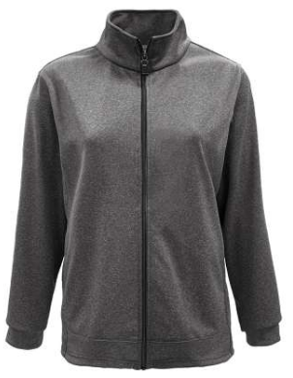
Men’s and Ladies’ Full Zip Jacket with Pockets
6.25 oz, 100% Polyester
Men’s 9518-BDI Available: Small to 4XL
Small to XL: | $41.00
2XL: | $43.00
3XL: | $45.00
4XL: | $47.00
Ladies’ 618-BDI Available: Small to 3XL
Small to XL: | $41.00
2XL: | $43.00
3XL: | $45.00
Black Navy Hunter Red Silver
Page 7

Slide 8
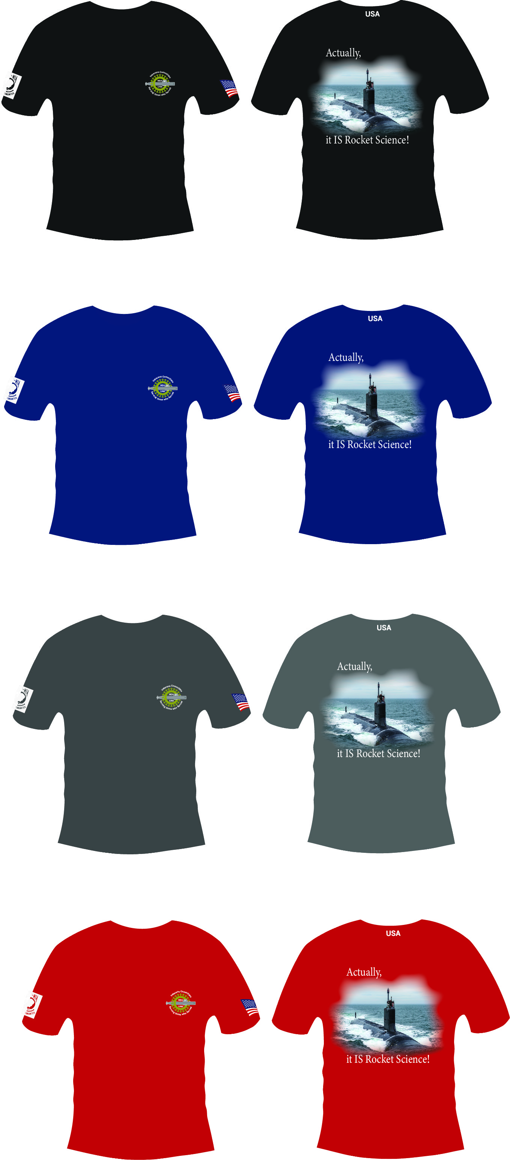
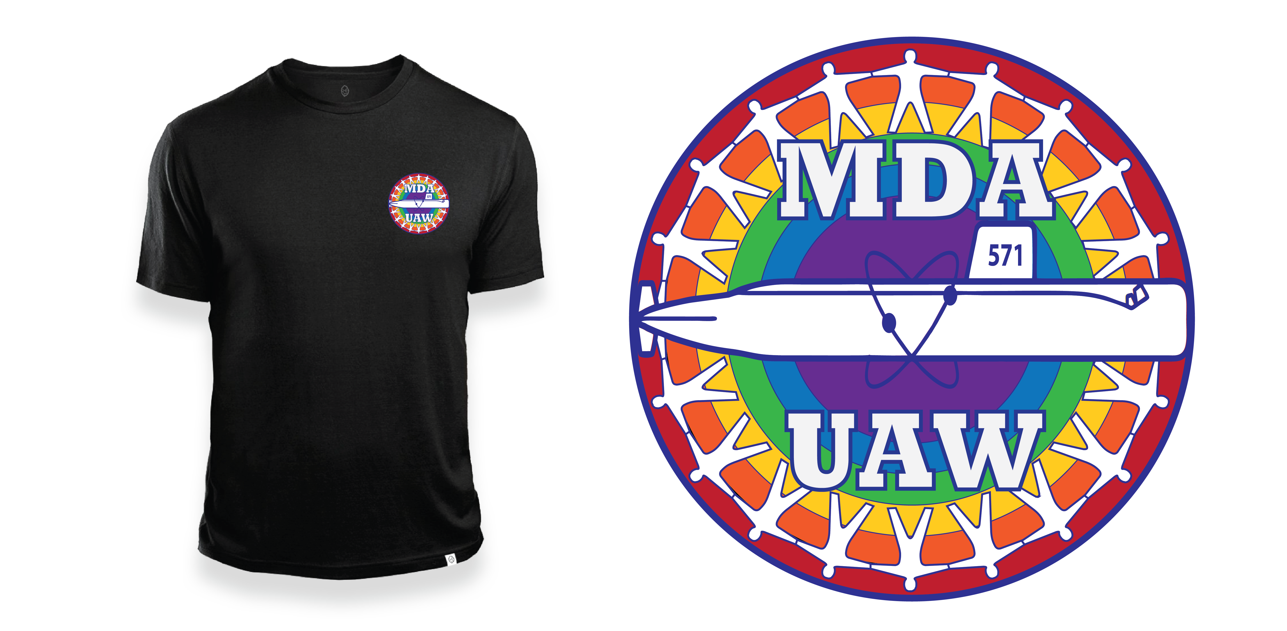
VETERANS COMMITTEE T-SHIRT
“IT IS ROCKET SCIENCE”
T-SHIRT with MDA LOGO
“MDA UAW PRIDE”
Screenprinted “It’s is Rocket Science”
or “MDA Pride” T-Shirt
is available in Black, Gray, Blue, or Red
Type | Size | Member Price
Mens | small to XL | $14.50
Mens | 2X | $16.25
Mens | 3X | $18.25
Mens | 4X | $19.00
Mens Tall | LG to XL | $16.25
Mens Tall | 2X | $17.25
Mens Tall | 3X | $18.25
Womens | small to XL | $13.75
Womens | 2X | $14.75
Womens | 3X | $15.35
Page 8

Slide 9


LOGO “A”
LOGO “B”
(Note: The gray lettering & the gray area of the submarine will be white on the apparel)
NOTE: TWO FREE ITEMS PER MEMBER ADDITIONAL ITEMS AVAILABLE IN THIS CATALOG ARE AT PRICES SHOWN | PAGE | DESCRIPTION & ITEM | COLOR | QTY | SIZE | LOGO A OR B FROM ABOVE | NAME (RIGHT CHEST) ADD $7.00 | SOLIDARITY TEXT (BACK OF NECK) ADD $7.00 | UAW WHEEL (RIGHT SLEEVE) ADD $10.00 | REGION 9A (LEFT SLEEVE) ADD $7.00
1ST FREE ITEM ONLY
2ND FREE ITEM ONLY
MEMBER PAID ITEM
MEMBER PAID ITEM
MEMBER PAID ITEM
MEMBER/RETIREE NAME | BADGE NUMBER | BUILDING LOCATION | WORK PHONE OR CELL
NOTE:
ALL ORDERS MUST BE PAID IN FULL
BEFORE ORDER WILL BE PLACED
Page 9

