Slide 1


MDA-UAW Local 571 Apparel
03/06/2024
Call the Union Office @ (860) 448-0552
choose
your
logo
(Note: The gray lettering & the gray area of the submarine will be white on the apparel)
Prices shown throughout the catalog are member prices.
All prices include our logo on the left chest
Additional embroidery is $7.50 per area:
  Name on right chest
  SOLIDARITY on back of neck below the collar
  UAW Wheel logo on right sleeve
  REGION 9A on left sleeve
Page 1

Slide 2
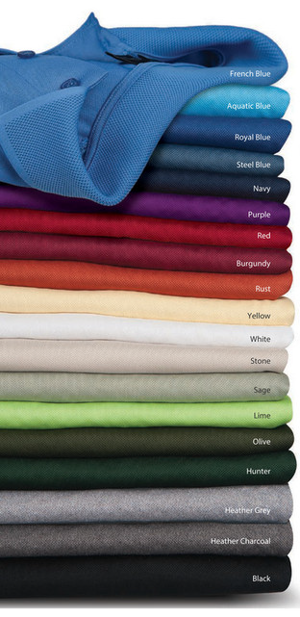
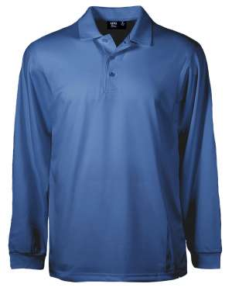
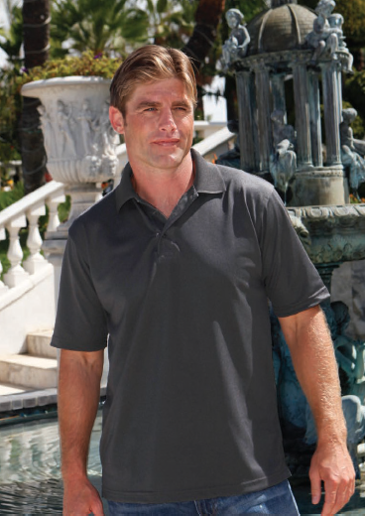





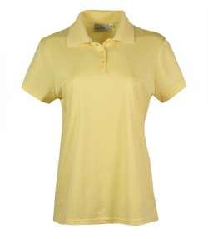

Polo Shirts
Men’s & Ladies’ Polo Shirts with MDA-UAW Local 571 logo custom embroidered on Left Chest
5.75 oz., 96/4 dry wicking poly/spandex
Superb no-curl collar
Snag resistant, wrinkle resistant
Color options for long sleeved
(slso available in charcoal)
Men’s
Navy Blue
French Blue
Red
Black
White
Charcoal
Men’s 1342-AQD Available: Small to 4XL
Ladies’ 234-AQD Available: Small to 3XL
Small to XL: $25.50
2XL: $27
3XL: $28.50
4XL: $30.50
Ladies
LS1342-AQD
Available: Small to 4XL
Small to XL: $27.50
2XL: $29
3XL: $30.50
4XL: $32.50
Color options for short sleeved
Page 2

Slide 3
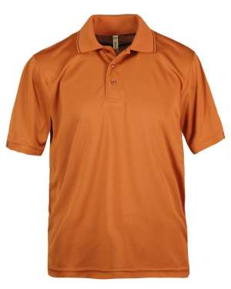
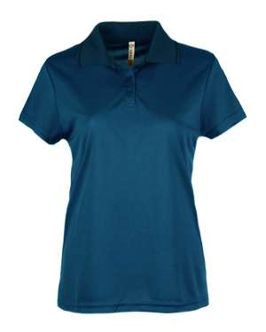






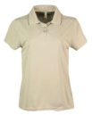
Men’s & Ladies’ Polo Shirts with MDA-UAW Local 571 logo custom embroidered on Left Chest
4.7 oz, 46/54 Bamboo Charcoal Viscose/Polyester Mesh
Silky soft bamboo inside against your skin
Bamboo is naturally dry wicking and antibacterial
Poly mesh on the outside for superior breathability
Dark tipping on the collar and cuffs
VERY comfortable shirt
Men’s 1353-BCM Available: Small to 4XL
Extra $5 for optional pocket
Ladies’ 208-BCM
Available: Small to 3XL
Small to XL: $25.50
2XL: $27
3XL: $28.50
4XL: $30.50
Ladies
Mens
Men’s only is also available in Rust color
Black Denim French Olive Red Silver Stone
Blue
Page 3

Slide 4
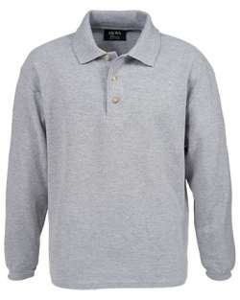
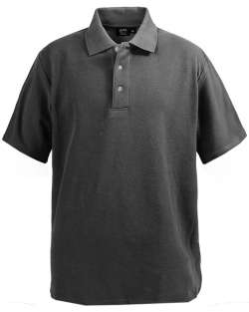
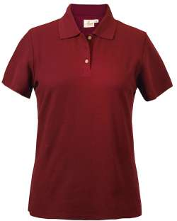






Men’s & Ladies’ Cotton Pique Polo Shirt with MDA-UAW Local 571 logo custom embroidered on Left Chest
6.5 oz. 100% prewashed cotton pique
Mens
Polo Shirts
Ladies
Long sleeve is only available in black, heather gray, navy blue and white
Men’s 2300-PK Available: Small to 4XL
Ladies’ 206-PK Available: Small to 3XL
Small to XL: $23.50
2XL: $25
3XL: $26.50
4XL: $28.50
Men’s LONG SLEEVE 2400-PK Available: Small to 4XL
Small to XL: $25.50
2XL: $27
3XL: $28.50
4XL: $30.50
Navy Blue Red White Charcoal Black Heather Gray
Page 4

Slide 5
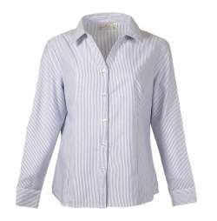
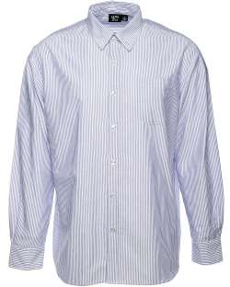
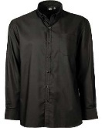
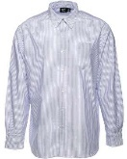
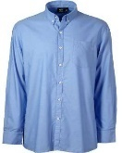
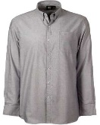
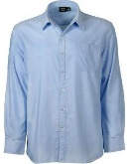
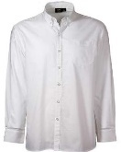
Men’s & Ladies’ Oxford Dress Shirts with MDA-UAW Local 571 logo custom embroidered on Right Chest
4.5 ox. 60/40 Cotton/Poly makes for easier care
Button down collard for men
Spread collar for ladies
Single button cuffs
Ladies’
Men’s
Ladies’ 391-OXF Available: Small to 3XL
Small to XL: $40
2XL: $41.50
3XL: $43
Black Light Blue Stripe French Blue
Grey Light Blue White
Men’s 1621-OXF Available: Small to 4XL
Small to XL: $43
2XL: $44.50
3XL: $46
4XL: $48
Page 5

Slide 6
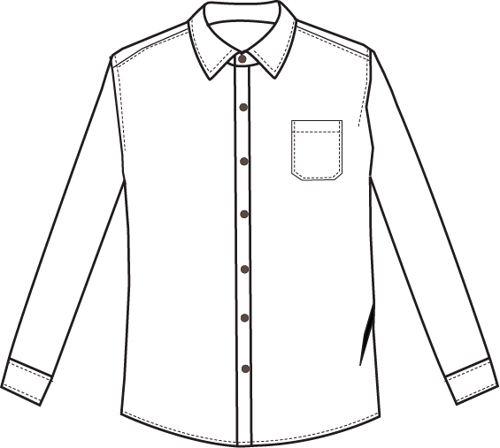
Sizing chart for Men’s & Ladies’ Oxford Dress Shirts
SHRINKAGE : Less than 3%
FABRIC : 60% COTTON , 40% POLYESTER Oxford
Flat Measurements In Inches | S | M | L | XL | 2XL | 3XL | 4XL | 5XL | 6XL
BODY LENGTH (C.B. ) | 30 | 31 | 32 | 33 | 33.5 | 34 | 34.5 | 34.5 | 34.5
ACROSS SHOULDER ( seam to seam ) | 19 | 20 | 21 | 22 | 23 | 24 | 25 | 26 | 27
CHEST 1" BELOW ARMHOLE 1/2 | 21.5 | 23 | 24.5 | 26 | 27.5 | 29 | 30.5 | 32 | 33.5
BOTTOM OPENING ( RELAXED )1/2 | 21.5 | 23 | 24.5 | 26.0 | 27.5 | 29 | 30.5 | 32 | 33.5
BOTTOM OPENING ( STRETCHED )1/2
ARMHOLE ( CURVE ) 1/2 | 10.5 | 11 | 11.5 | 12 | 12.5 | 13 | 13.5 | 14 | 14.5
SLEEVE LENGTH ( C.B. ) | 33.0 | 34.0 | 35.0 | 36.0 | 37.0 | 37.5 | 38.0 | 38.5 | 39
SLEEVE PLACKET LENGTH | 6.5 | 6.5 | 6.5 | 6.5 | 6.5 | 6.5 | 6.5 | 6.5 | 6.5
CUFF OPENING 1/2 | 4.25 | 4.5 | 4.75 | 5 | 5.25 | 5.50 | 5.75 | 6.00 | 6.25
CUFF HEIGHT | 2.25 | 2.25 | 2.25 | 2.25 | 2.25 | 2.25 | 2.25 | 2.25 | 2.25
NECK OPENING | 15 | 16 | 17 | 18 | 19 | 20 | 21 | 22 | 23
FRONT COLLAR POINT | 2.875 | 2.875 | 2.875 | 3 | 3 | 3 | 3 | 3 | 3
COLLAR HIGH (C.B.) | 1.75 | 1.75 | 1.75 | 1.75 | 1.75 | 1.75 | 1.75 | 1.75 | 1.75
INSIDE COLLAR HEIGHT (C.B.) | 1.25 | 1.25 | 1.25 | 1.25 | 1.25 | 1.25 | 1.25 | 1.25 | 1.25
COLLAR SPREAD | 3 | 3 | 3 | 3.25 | 3.25 | 3.25 | 3.25 | 3.25 | 3.25
PLACKET WIDTH | 1.375 | 1.375 | 1.375 | 1.375 | 1.375 | 1.375 | 1.375 | 1.375 | 1.375
POCKET WIDTH | 5 | 5 | 5 | 5 | 5.5 | 5.5 | 5.5 | 5.5 | 5.5
POCKET HIGHT | 5.75 | 5.75 | 5.75 | 5.75 | 6.25 | 6.25 | 6.25 | 6.25 | 6.25
POCKET PLACEMENT: from shoulder seam HP to the top of pocket |  | 7.75 | 8 | 8.25 | 8.5 | 8.75 | 9 | 9.25 | 9.5 | 9.75
POCKET PLACEMENT:from edge of placket to the edge of pocket |  | 2.75 | 3 | 3.25 | 3.5 | 3.75 | 4 | 4.25 | 4.5 | 4.75
Page 6

Slide 7
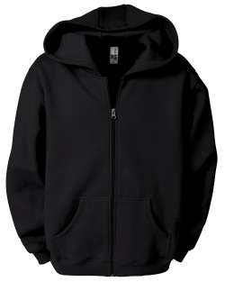
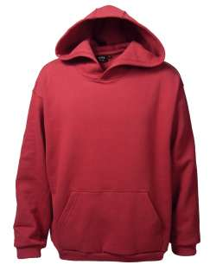
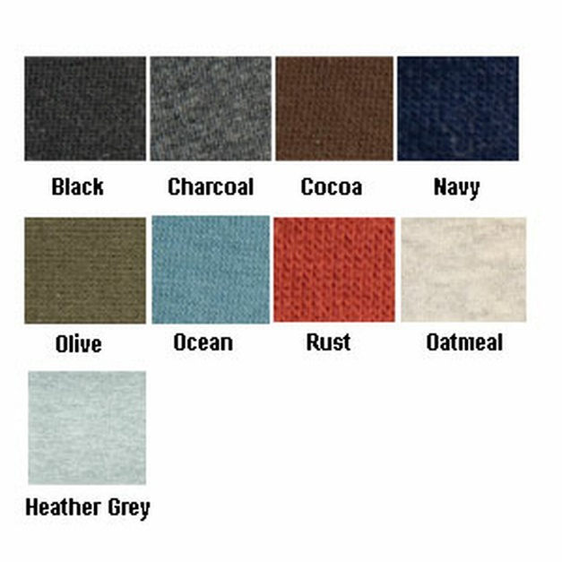











Men's Full Zip Fleece Hoodie
Cotton Polyester Fleece (CVC)
10 oz, 80/20 Cotton/Polyester
3 pc hood for a more rounded look
Beautiful taping and finish work
No drawcords to get in your way
Spandex ribbed cuffs and hemline.
Available in: Black, Charcoal, Heather Gray, Navy Blue, Red
Men's Pullover Fleece Hoodie
Cotton Polyester Fleece (CVC)
10 oz, 80/20 Cotton/Polyester
3 pc hood for a more rounded look
Beautiful taping and finish work
No drawcords to get in your way.
Available in: Black, Charcoal, Navy Blue, Ocean, Olive, Heather Grey, Oatmeal, Red, Rust, Cocoa
1746-CVC
Full Zip Hoodie
Available: Small to 4XL
Small to XL: $35
2XL: $36.50
3XL: $38
4XL: $40
1736-CVC Pullover Hoodie
Available: Small to 4XL
Small to XL: $28.50
2XL: $30
3XL: $31.50
4XL: $33.50
The Full Zip Hoodie is only available in the 5 colors listed above. The Pullover Hoodie has all 10 colors shown.
Red
Page 7

Slide 8
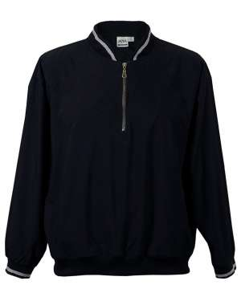
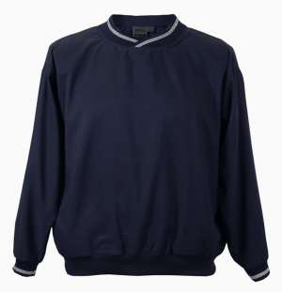









Microfiber Windshirt Pullover
4.0 oz, 100% Water Repellent Poly with Peached Finish
Microfiber Windshirt 1/4 zip
4.0 oz, 100% Water Repellent Poly with Peached Finish
Quarter Zip Windshirt
9413-MFI
Available: Small to 4XL
Small to XL: $28.50
2XL: $30
3XL: $31.50
4XL: $33.50
Pullover Windshirt
9013-MFI
Available: Small to 4XL
Small to XL: $25.50
2XL: $27
3XL: $28.50
4XL: $30.50
Navy Blue Charcoal Black French Blue Khaki
Page 8

Slide 9
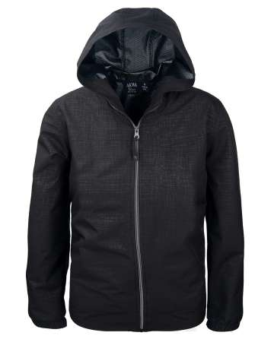
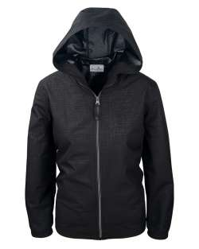




Men’s and Ladies’ Full Zip Wind Jacket
3.25 oz, 100% Polyester Woven
Water repellent & wind proof
Very lightweight
Printed polyurethane interior
Men’s
Men’s 9306-WBK Available: Small to 4XL
Ladies’ 306-WBK Available: Small to 3XL
Small to XL: $48
2XL: $49.50
3XL: $51
4XL: $53
Ladies’
Black
Black
Heather Heather Steel Navy
Charcoal Grey Blue Blue
Page 9

Slide 10
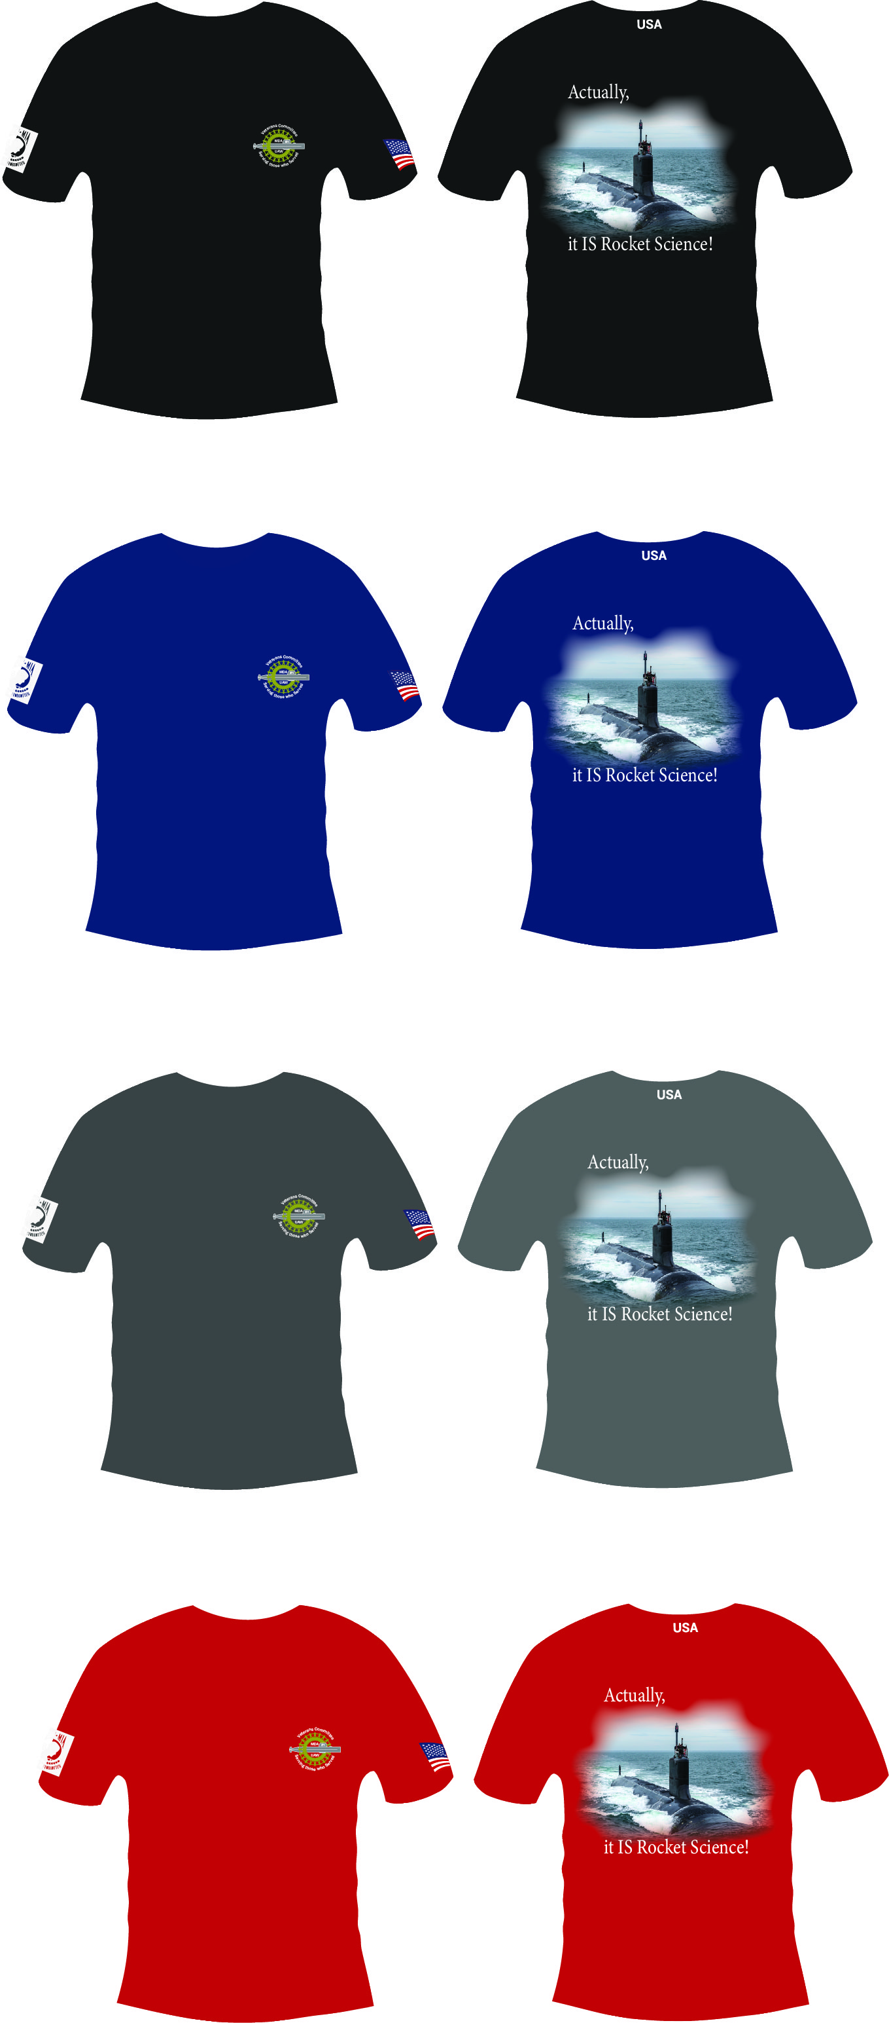
VETERANS COMMITTEE T-SHIRT
“IT IS ROCKET SCIENCE”
BLACK
AVAILABLE IN 4 COLORS
BLUE
Size | S | M | L | XL | 2XL | 3XL | 4XL
body length | 26 | 28 | 30 | 31 | 32 | 33 | 34
body width | 18 | 20 | 22 | 24 | 26 | 28 | 30
MDA MEMBER PRICING
Type | Size | Price
Mens | small to XL | $13.25
Mens | 2X | $14.25
Mens | 3X | $14.75
Mens | 4X | $15.25
Mens Tall | small to XL | $16.25
Mens Tall | 2X | $17.25
Mens Tall | 3X | $18.25
Womens | small to XL | $13.75
Womens | 2X | $14.75
Womens | 3X | $15.35
GRAY
RED
Page 10

Slide 11
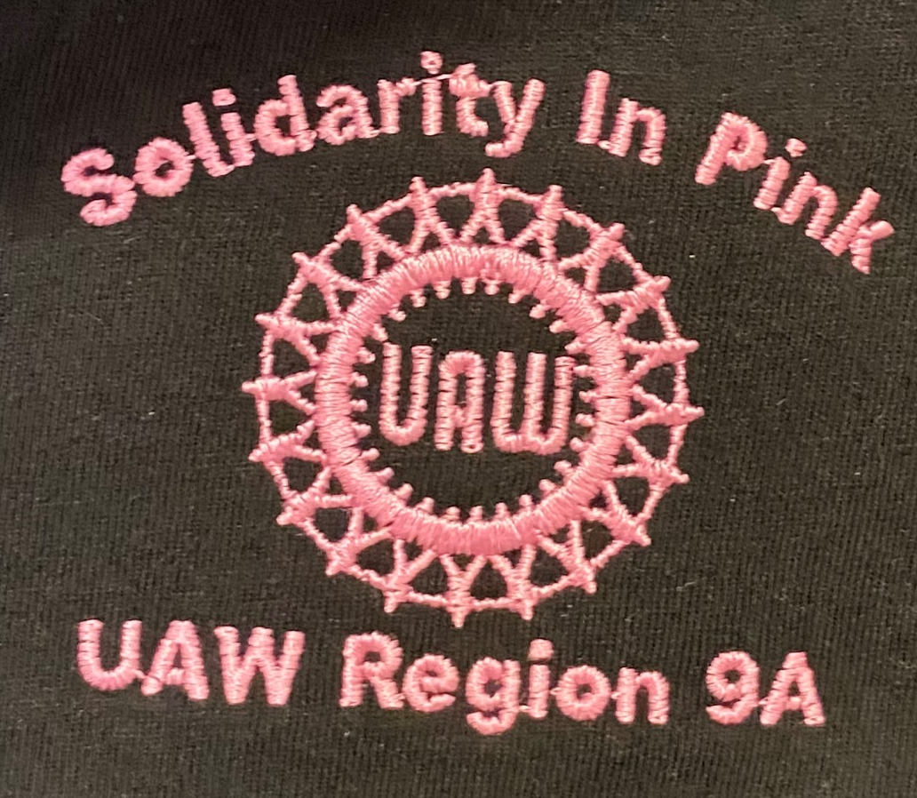
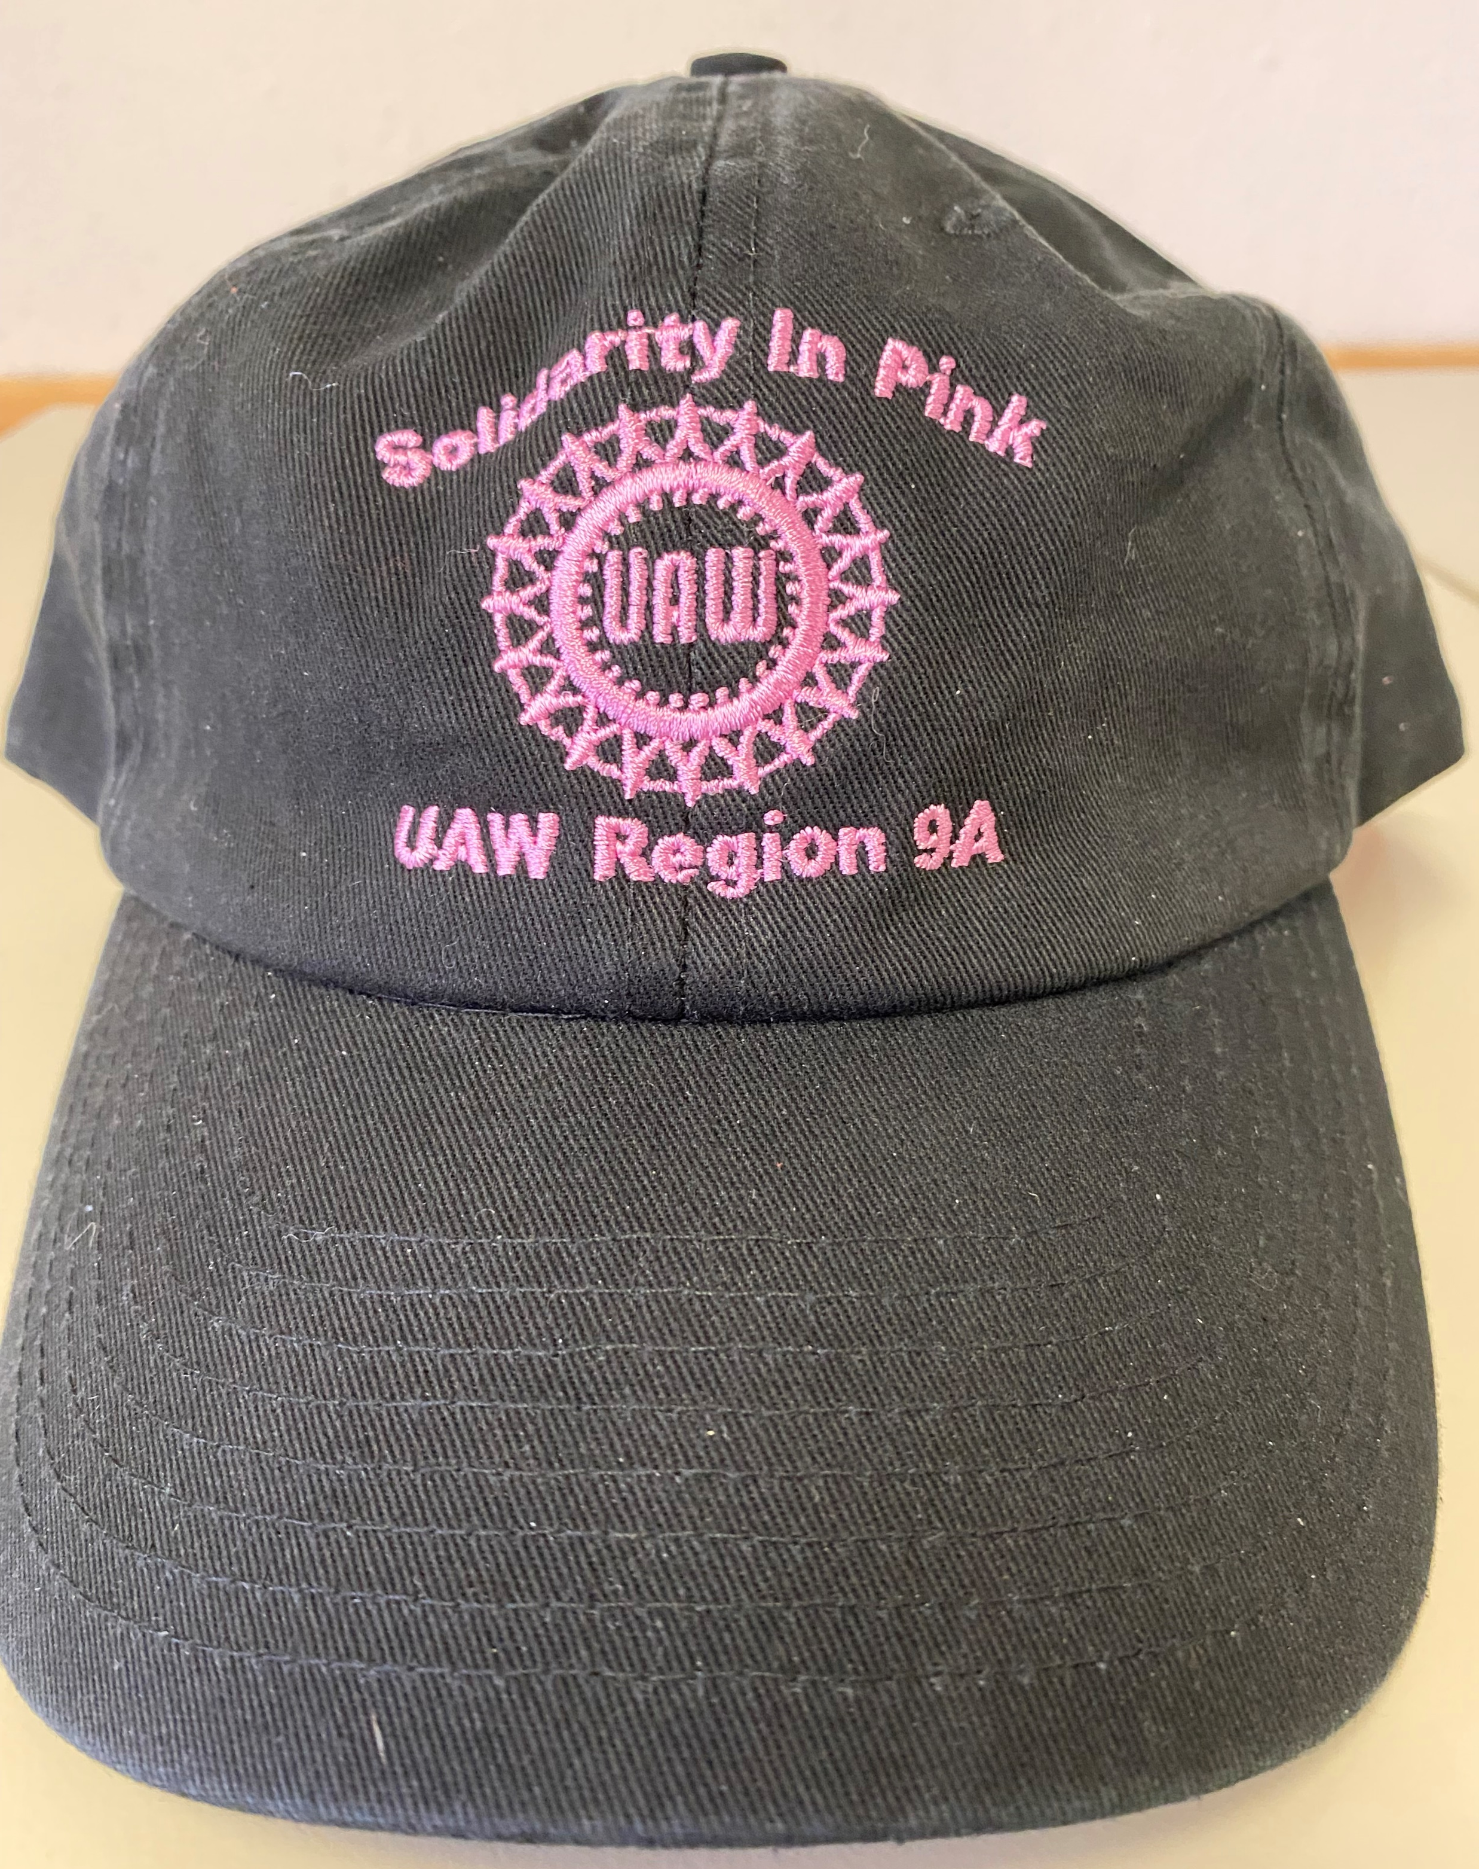
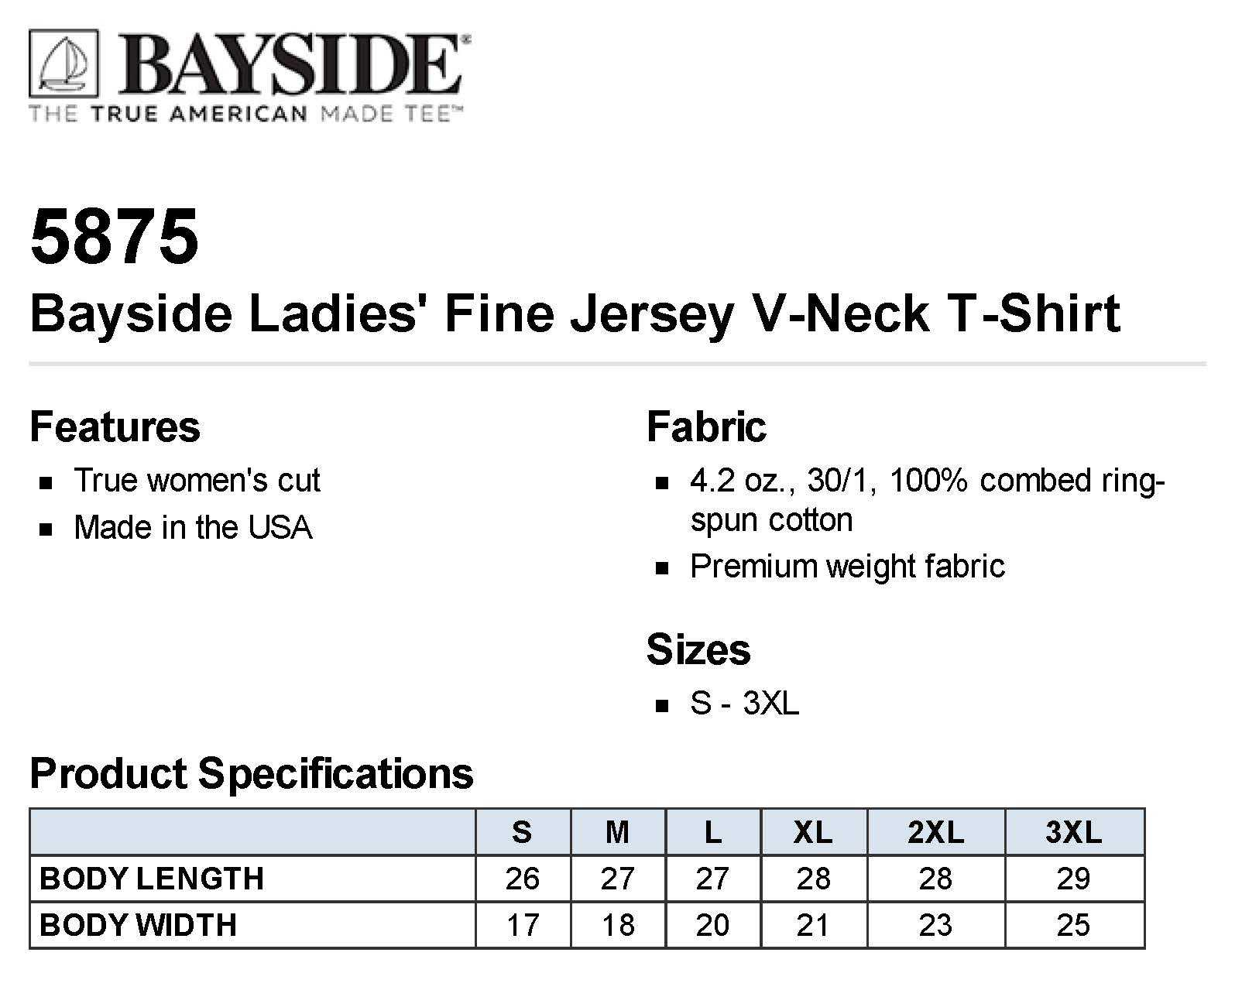
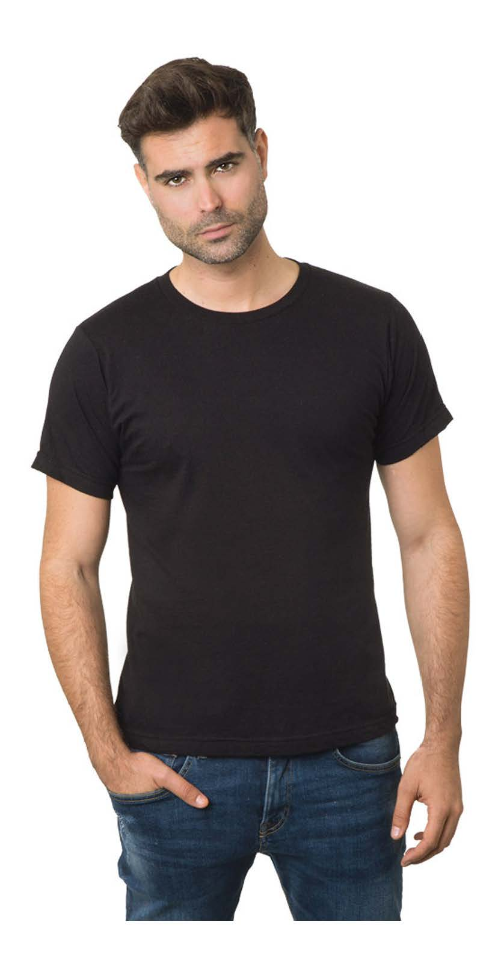
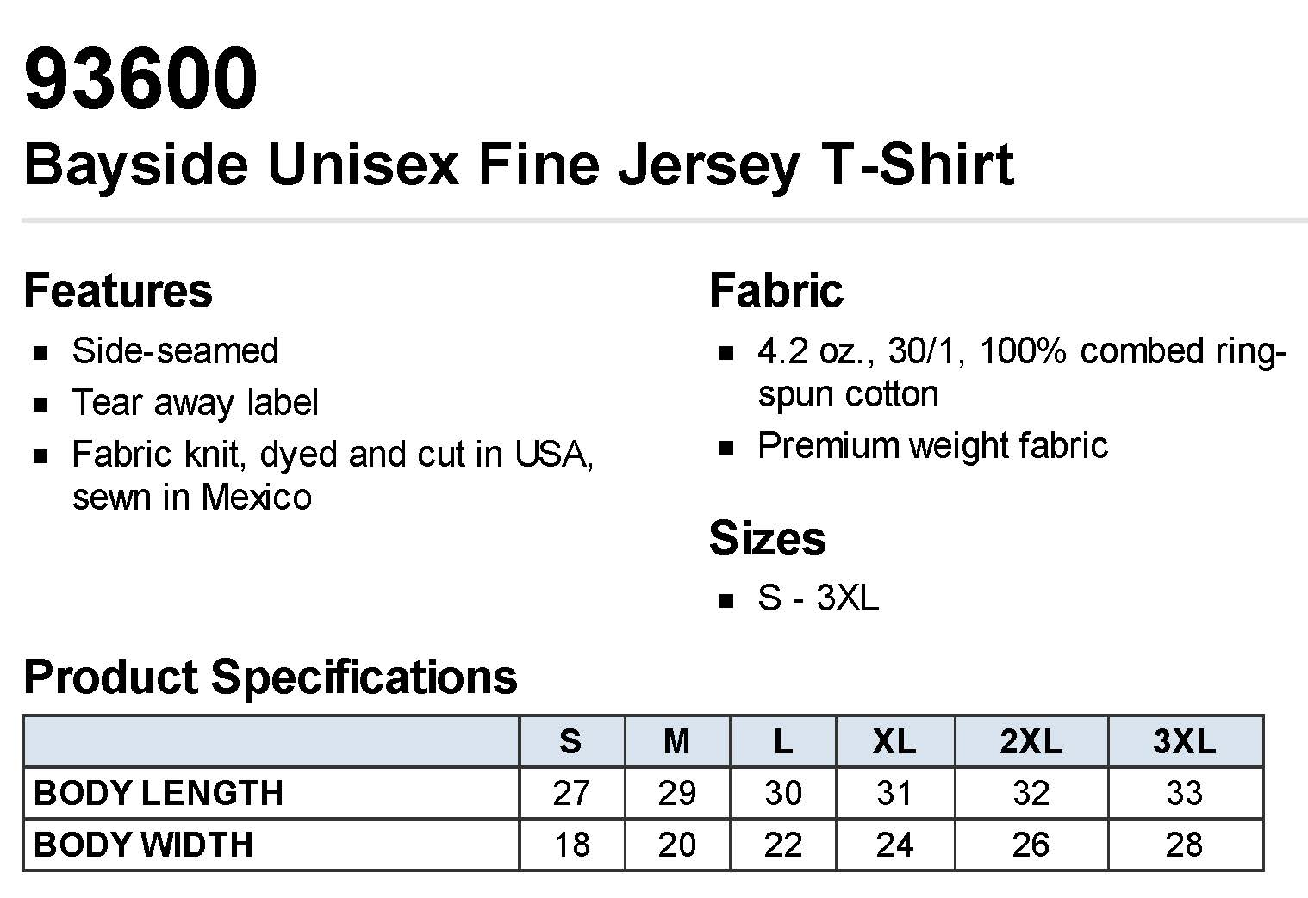
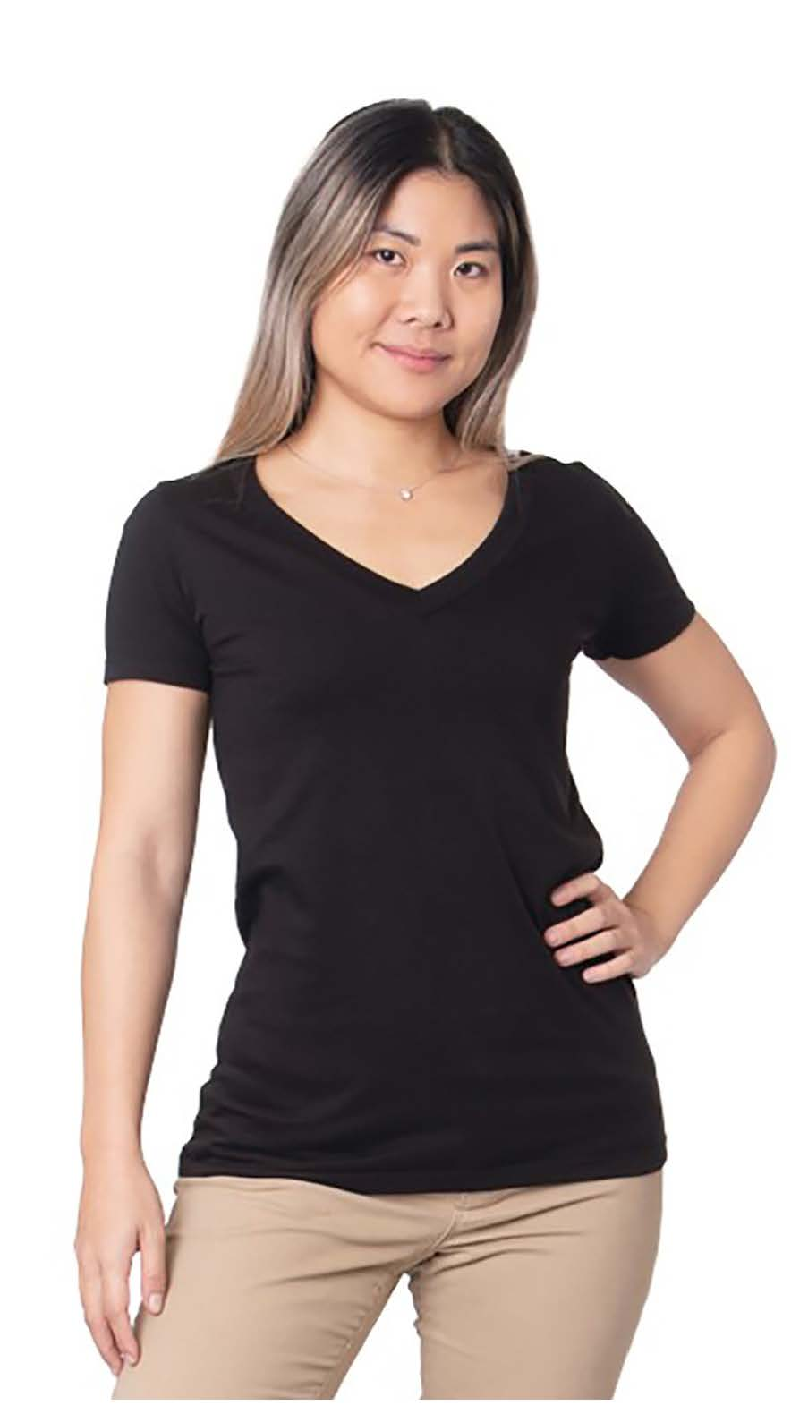
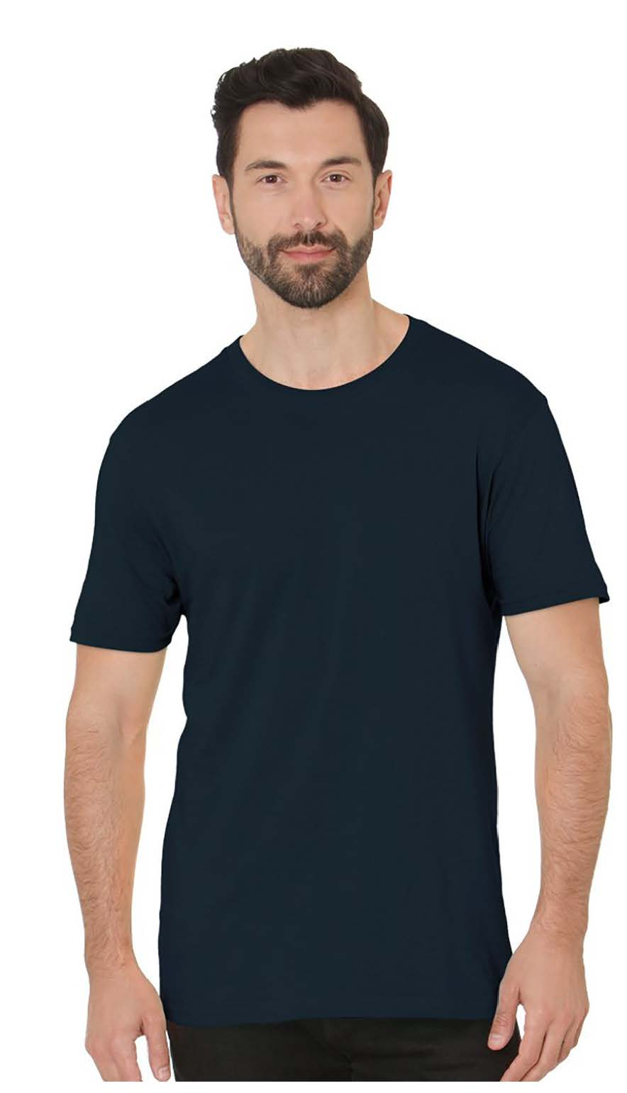
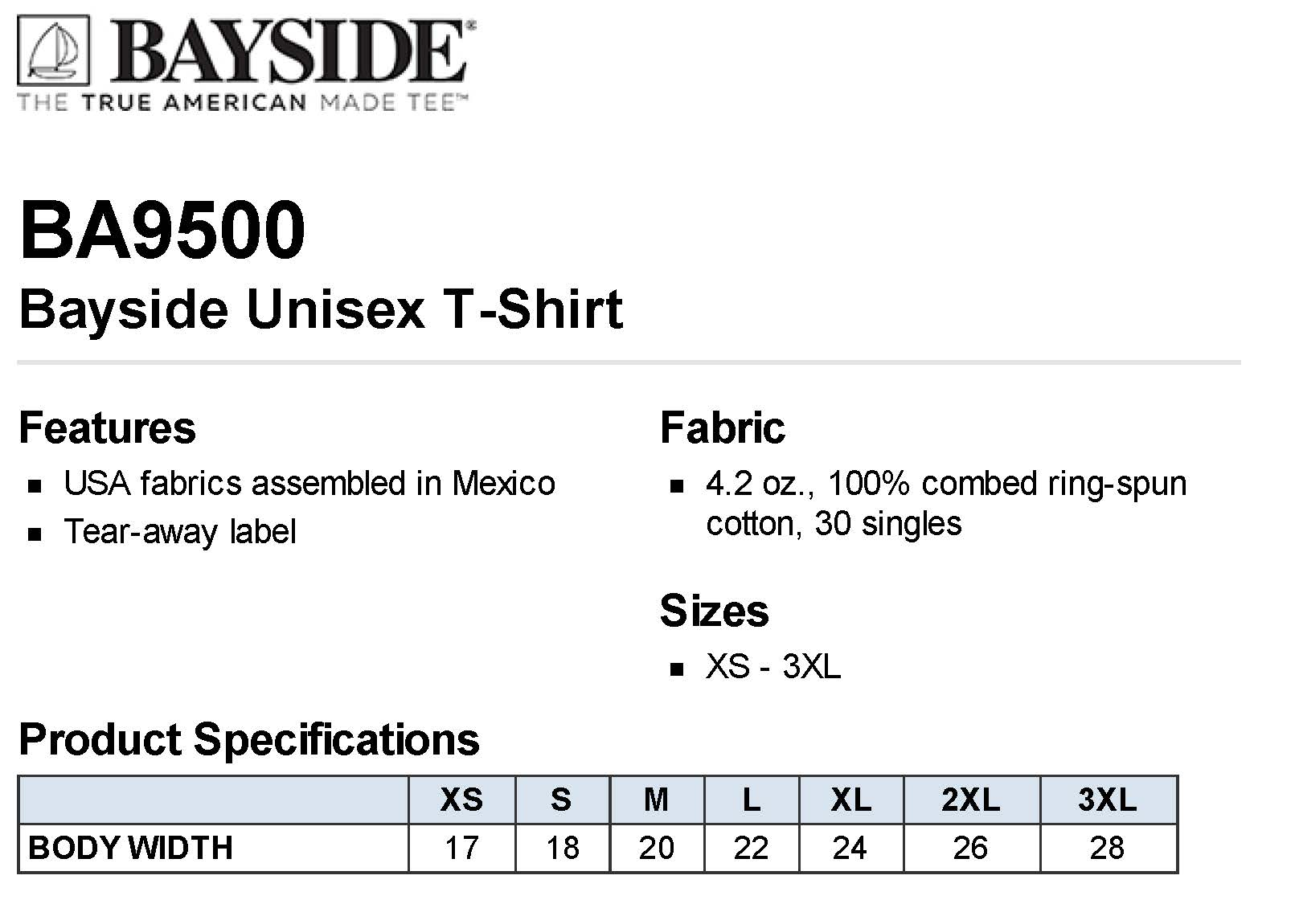
SOLIDARITY IN PINK T-SHIRT
UAW REGION 9A
Ladies’/Unisex T-Shirt
SM – XL | $15.50
2XL | $17.50
3XL | $18.50
Hat
$10.00
Page 11

Slide 12


Minimum order is 12 items … will go as low as 6 if necessary
 |  |  | Select which LOGO you are ordering
MDA-UAW Local 571 Apparel
All info and prices are attached. All prices shown are what the member pays.
All money is due upon receipt of your items.
 |  |  |  |  | Name on Shirt | SOLIDARITY | UAW Wheel Logo | Region 9A
PAGE | DESCRIPTION/ITEM NUMBER | COLOR | QTY | SIZE | (right chest) | on back of neck below collar | on right sleeve | on left sleeve

